Slide 1

‘MSM4PCoD’ – Marine Species Monitoring for the Population Consequences of Disturbance (project 43)
Cormac Booth
SMRU Consulting (UK)
+358-40-321-9235
cgb@smruconsulting.com MSM 2023
Tuesday 25th April 2023
Pre-decisional document For Discussion Purposes Only and Is Privileged from Release in Whole or in Part without the Personal and Specific Approval of the LMR Program. Not subject to discovery or release under P.L. 93-502 (5 U.S.C. § 552).
.

Slide 2












Project Team (& additional support)
MSM4PCoD is wholly funded by LMR
Project Team:
Cormac Booth (PI)
Megan Ryder
Magda Chudzinska
Vincent Hin
Eiren Jacobson
Len Thomas
John Harwood
2

Slide 3
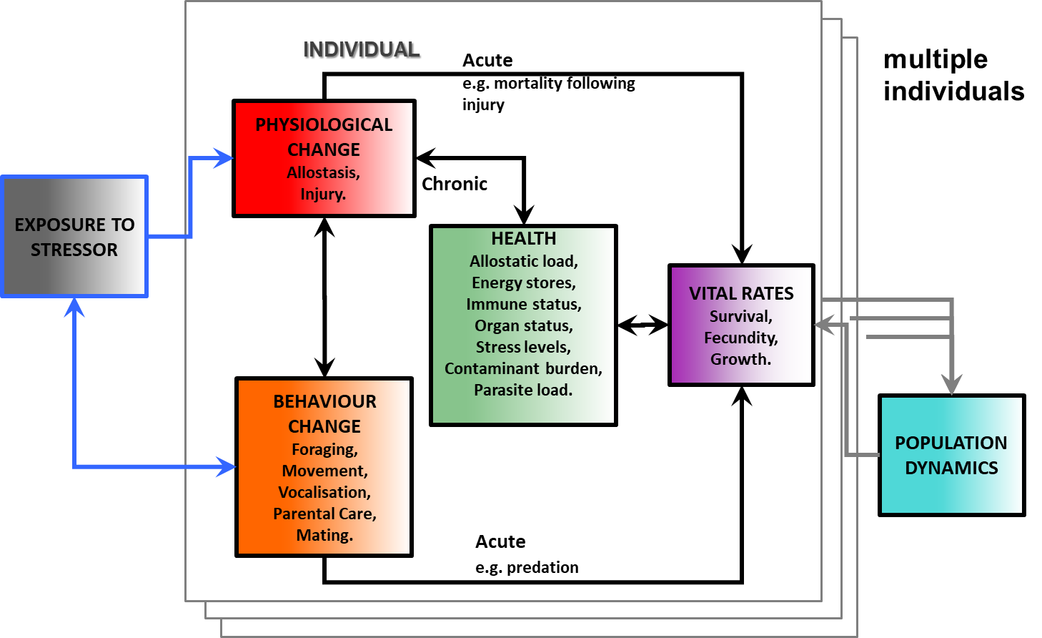
Background
Population Consequences of Disturbance Framework (Pirotta, et al 2018)
Efforts builds on over a decade of ONR funded PCoD research
How to monitor best for population changes?
EARLY WARNING
?
?
Slow to change
Hard to detect

Slide 4
Background
Marine Species Monitoring – projects for 15-20 years
Data collection done under Occurrence, Exposure, Response and Consequences
How does PCoD fit into the existing MSM program?
Response
Consequences
Occurrence
Exposure

Slide 5
BACKGROUND – ISO CONCEPTS
Intermediate Scientific Objectives | Which components of the conceptual framework does this question address?
Determine what species and populations of marine mammals and ESA-listed species are present in Navy range complexes, testing ranges, and in specific training and testing areas | Occurrence
Estimate the distribution, abundance, and density of marine mammals and sea turtles in Navy range complexes, testing ranges, and in specific training and testing areas | Occurrence
Determine what species and populations of marine mammals and ESA-listed species are exposed to Navy training and testing activities | Occurrence, Exposure
Establish the baseline habitat uses and movement patterns of marine mammals and sea turtles where Navy training and testing activities occur | Occurrence, Response
Establish the baseline behavioral patterns(foraging, diving, etc.) of marine mammals where Navy training and testing activities occur | Occurrence, Response
Establish the regional baseline vocalization behavior, including seasonality and acoustic characteristics) of marine mammals where Navy training and testing activities occur | Occurrence, Response
Determine what behaviors can most effectively be assessed for potential response to Navy training and testing activities | Response
Application of passive acoustic tools and techniques for detecting, classifying, and tracking marine mammals | Occurrence, Exposure, Response
Application of analytic methods to evaluate exposure and/or behavioral response of marine mammals to Navy training and testing activities ¹ | Exposure, Response
Evaluate acoustic exposure levels associated with behavioral responses of marine mammals to support development and refinement of acoustic risk functions | Exposure, Response
Evaluate behavioral responses of marine mammals exposed to Navy training and testing activities to support PCoD development and application | Response, Consequences
Evaluate trends in distribution and abundance for populations of marine mammals and ESA-listed species that are regularly exposed to sonar and underwater explosives | Exposure, Response , Consequences
Leverage existing data with newly developed analysis tools and techniques ¹ | Occurrence, Exposure, Response, Consequences
Evaluate behavioral responses of marine mammals exposed to Navy training and testing activities to support PCoD development and application | Response, Consequences
Evaluate trends in distribution and abundance for populations of marine mammals and ESA-listed species that are regularly exposed to sonar and underwater explosives | Exposure, Response, Consequences
Leverage existing data with newly developed analysis tools and techniques | Occurrence, Exposure, Response, Consequences
http://www.navymarinespeciesmonitoring.us/index.php/download_file/1390/

Slide 6
‘MSM4PCoD’ Technical Objectives
Main objective
Review the Navy Marine Species Monitoring (MSM) program to explore how efforts could be adapted to inform future PCoD analyses.
1. How might 15-20y of MSM effort inform future PCoD analyses and fill knowledge gaps in framework
2. Explore the power for monitoring efforts to identify early warnings of change.
EARLY WARNING

Slide 7
‘MSM4PCoD’ Technical Approach
Project Structure
Task 1: Review MSM projects (species & methods) & Database compilation
Task 2: Select suitable metrics for monitoring
Task 3: Assess power of existing MSM program to inform PCoD analysis & future needs
MSM Program & Navy stakeholder feedback
Task 4: Recommendations for future MSM program to monitoring population change and inform PCoD analyses

Slide 8
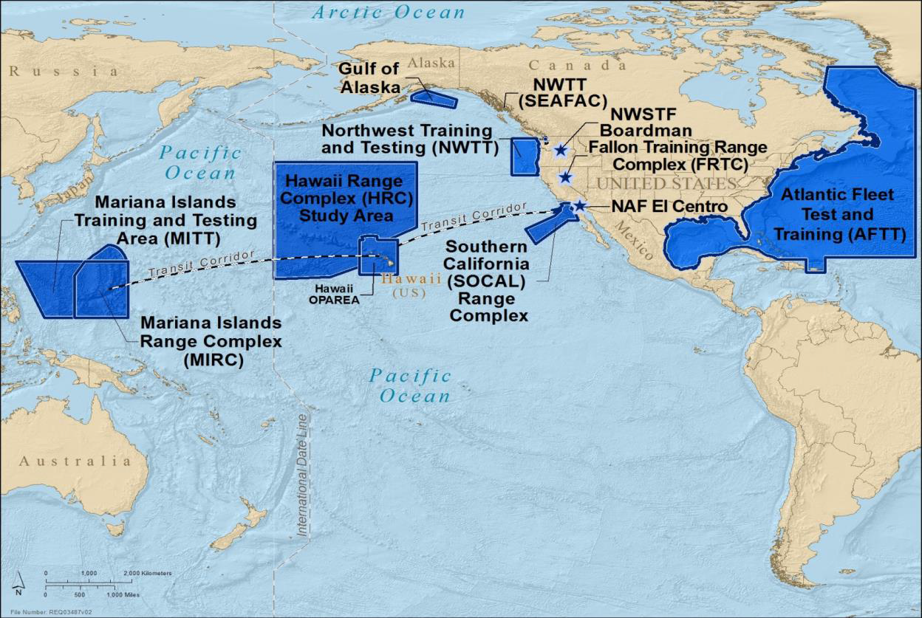
Priorities – summary - SPECIES
Pacific:
Cuvier’s beaked whale
Mesoplodon spp.
Humpback whale
Blackfish species
SF pilot whale
Pseudorca
PMRF PAM
Minke, Bryde’s whale
Atlantic:
Cuvier’s beaked whale
SF pilot whale
Sperm whale
Humpback whale
Fin whale
NA Right whale
Hawaii-Southern California Training and Testing (HSTT)
Total scope - Reviewing:
15 Atlantic survey programs
14 Pacific survey programs

Slide 9
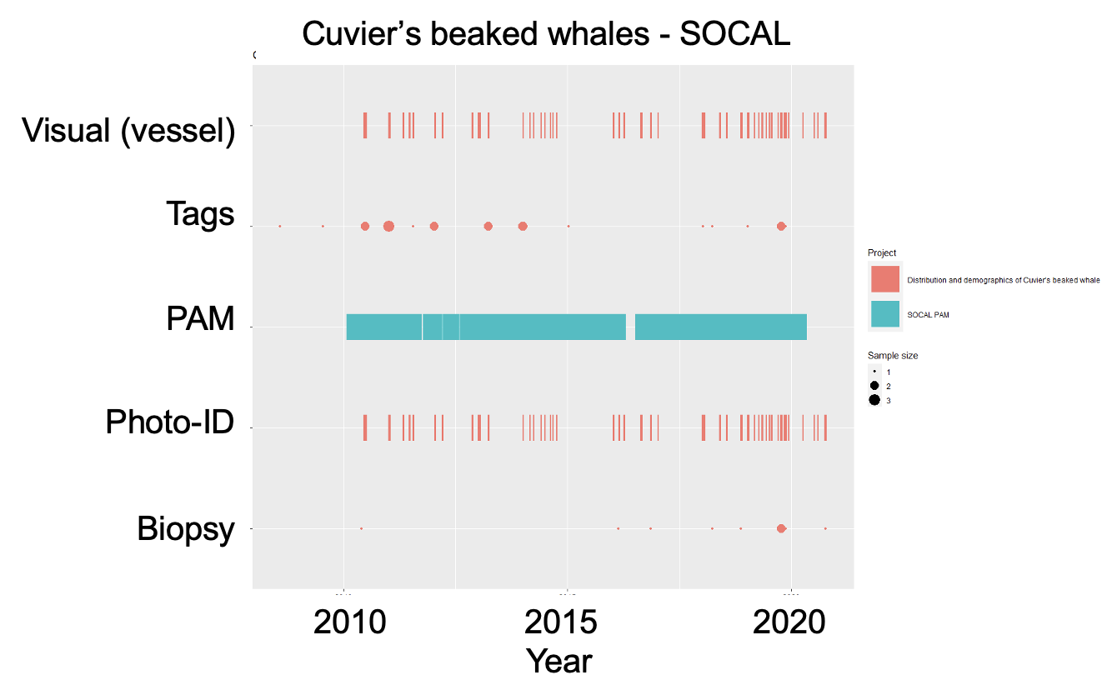
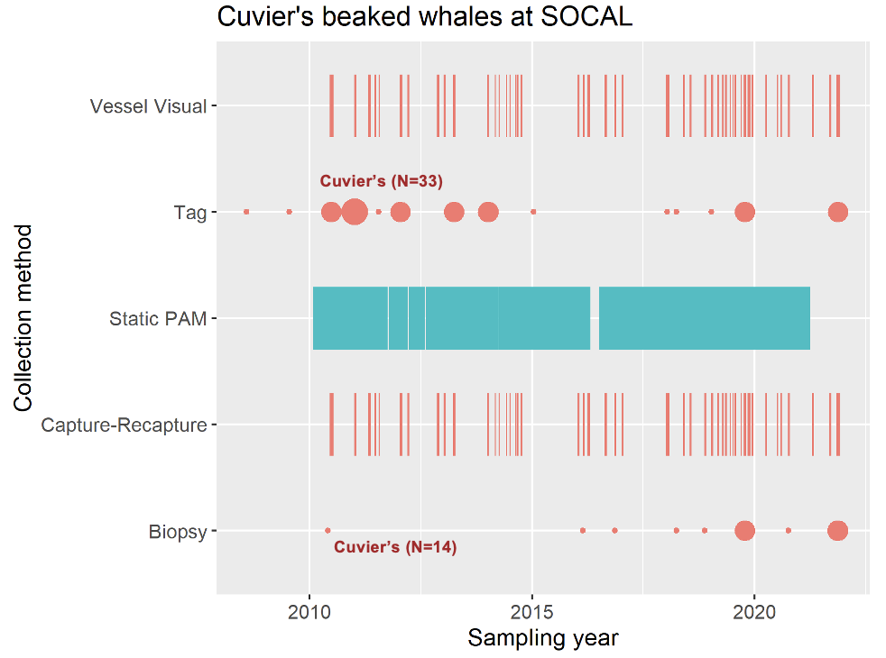
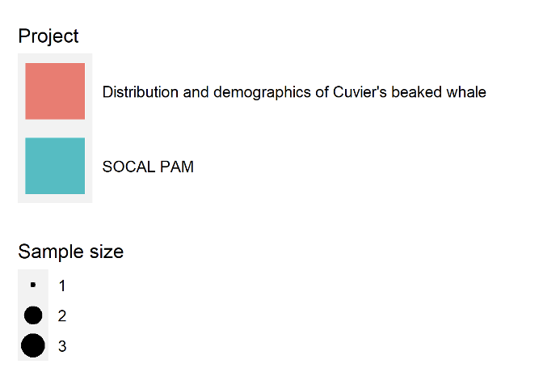
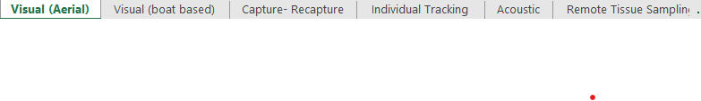
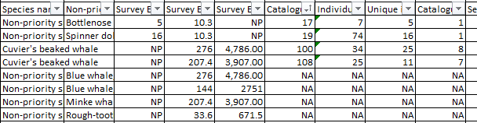
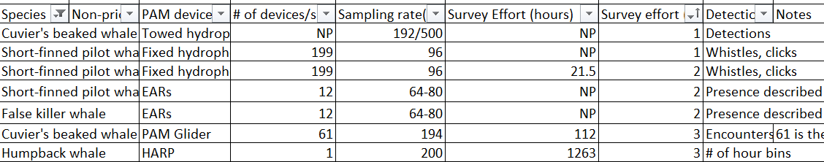
Task 1: Review database
Reviewed 15 Atlantic survey programs & 14 Pacific survey programs
The ‘Atlantic’ & ‘Pacific’ review spreadsheets for MSM4PCoD are essentially completed, with the exception of studies from 2021 that are being periodically uploaded - .xlsx
Each spreadsheet contains a tab for each data type
The data columns were created to be specific to data collection method (e.g)
Capture - Recapture
Catalog info
Visual survey effort
Acoustic (PAM)
PAM device
# of detections
Recording hours
Currently in Excel
What’s the best format for these amassed meta-data
- e.g. R Shiny app – web interface
Notes:
As you can see, some of the data fields have NP or NA, NP for not provided information, and NA for cases where the column isn’t relevant to the row (for example when listing non priority species, catalog size not relevant and cant be written as one number as multiple species in the same row). These spreadsheets exist for both the Atlantic and Pacific region, with all available reports being sourced through the navy website.

Slide 10
‘MSM4PCoD’ Technical Approach
Project Structure
Task 1: Review MSM projects (species & methods) & Database compilation
Task 2: Select suitable metrics for monitoring
Task 3: Assess power of existing MSM program to inform PCoD analysis & future needs
MSM Program & Navy stakeholder feedback
Task 4: Recommendations for future MSM program to monitoring population change and inform PCoD analyses

Slide 11
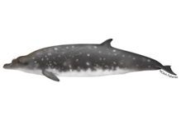
PROGRESS - TASK 2: METRICS
Bioenergetic models can provide insights into the potential population consequences of disturbance that reduces energy intake or increases energy expenditure.
Energetics-based PCoD models have been, or are being, developed for:
Blue whale
Minke whale
Gray whale
North Atlantic right whale
Humpback whale
Bottlenose dolphin
Long-finned pilot whale
Harbor porpoise
Blainville’s beaked whale
Cuvier’s beaked whale
Sperm whale
as well as a number of pinniped species
Maintenance
Other activities
Energy from prey
Reserves

Slide 12
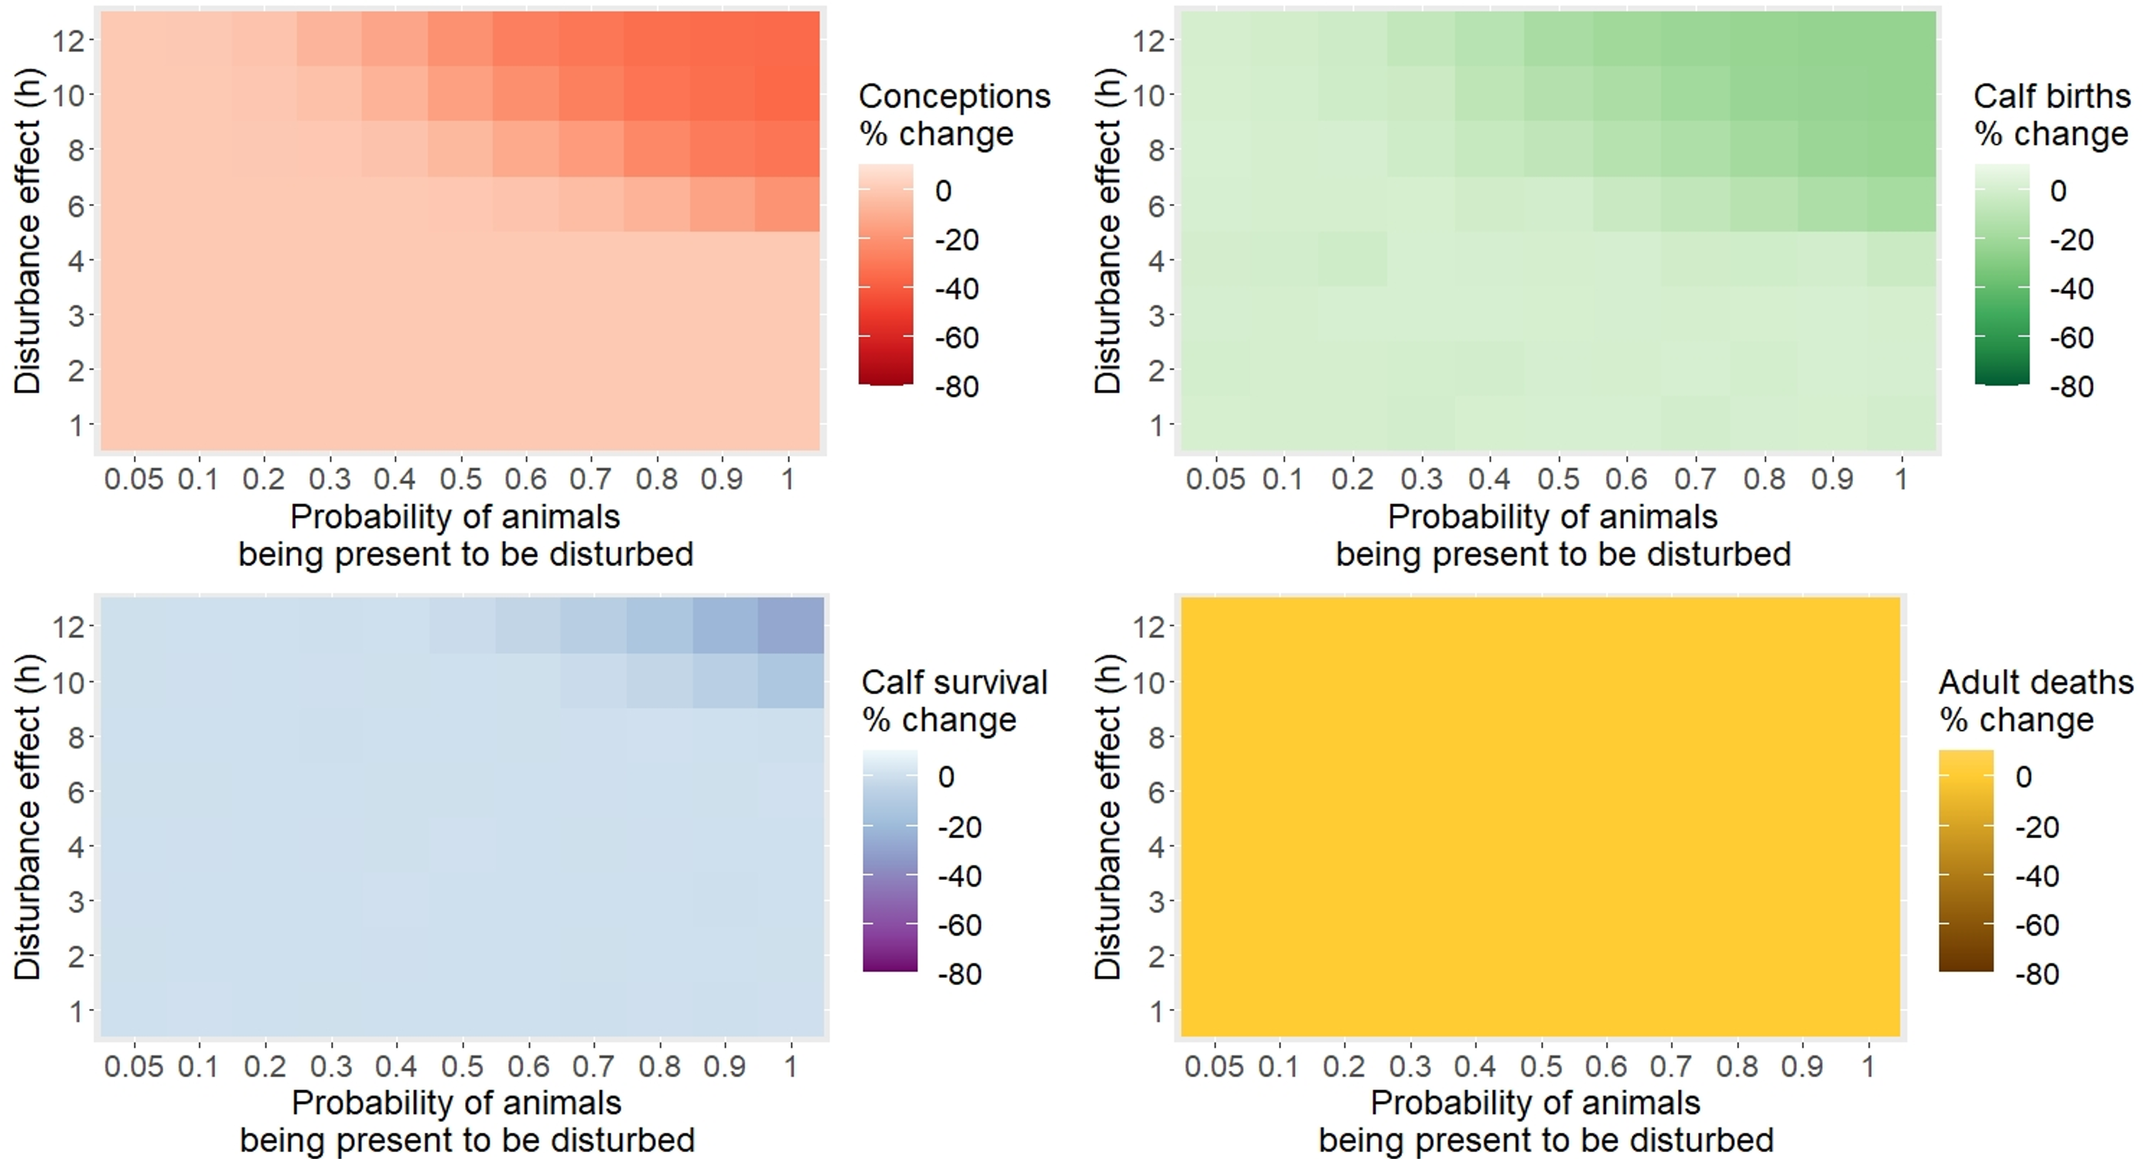
Task 2: METRICS - bioenergetics
Change in demographic rates follow ecological theory when foraging intake reduced
Reduced foraging can lead to reduced conceptions, calf births, calf survival
Results are heavily dependent on assumptions on the effect of disturbance and the degree of residence of the population

Slide 13
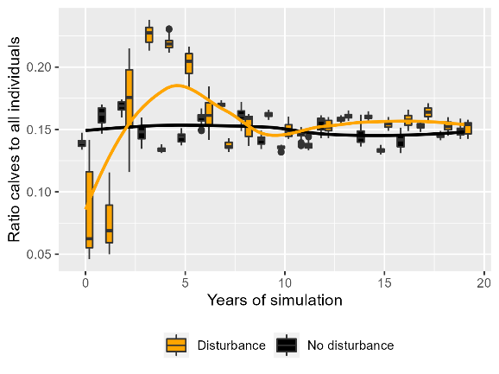
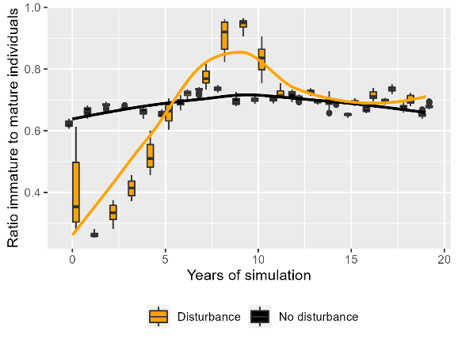
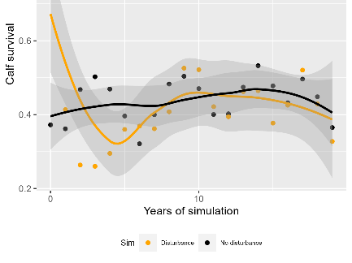
Task 2 Metrics – bioenergetics – Cuvier’s
Density / Indices
PAM, visual surveys
Models predict difference – but hard to monitor
Otherwise we’re interested in metrics that we can monitor with precision
Using existing or emerging methods
Adult : Calf ratio
Calf survival
Immature
vs Mature
Ratio
INITIAL
RESULTS

Slide 14
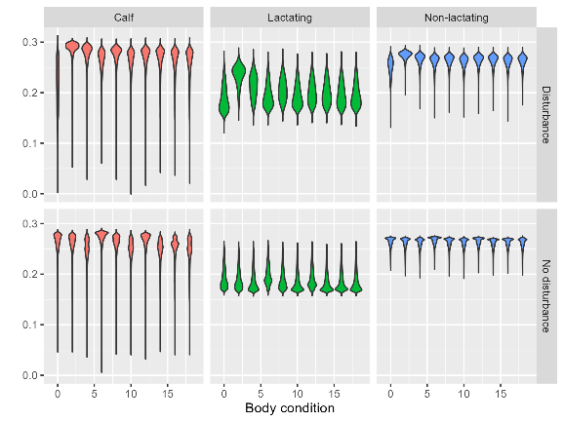
Task 2 Metrics – bioenergetics – Cuvier’s
Body condition
Disturbance No disturbance
Some interesting counter-intuitive impacts – possibly affecting utility of body condition metrics
Calves, early breeding females and senescent females die off
Survivors do well – so broader range of body condition
Cuvier's beaked whale model (adapted Hin et al in prep)
Model highlights key uncertainties
Effect of disturbance (in terms of lost energy intake)
Quality of the environment
Compensation opportunities
Many of the strongest varying metrics are ones we can (theoretically) monitor:
A:C ratio, I:M ratio, stage-specific survival etc.
Years

Slide 15
‘MSM4PCoD’ Technical Approach
Project Structure
Task 1: Review MSM projects (species & methods) & Database compilation
Task 2: Select suitable metrics for monitoring
Task 3: Assess power of existing MSM program to inform PCoD analysis & future needs
MSM Program & Navy stakeholder feedback
Task 4: Recommendations for future MSM program to monitoring population change and inform PCoD analyses

Slide 16
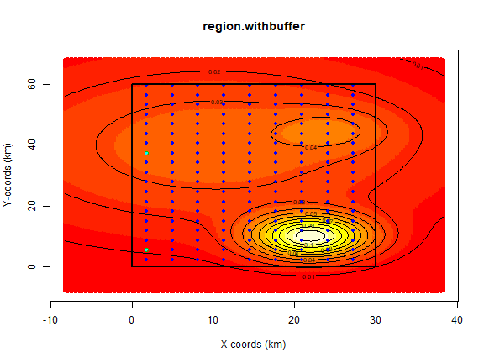
Task 3: explorative power analysis (PAM)
Aim: To evaluate the potential power of PAM to detect declines of Cuvier’s beaked whale at SOAR, using the AVADECAF Tool
The AVADECAF PAM Power tool was designed to:
Evaluate the power to detect declines in density from PAM
Help us to understand the time required to detect a change in cetacean density
Array area dimensions
Simulated Array
Non localising hydrophones
Localising hydrophones
Non uniform beaked whale density

Slide 17
Task 3: explorative power analysis (PAM)
Power to detect declines increases above 80% after 40 years of monitoring (1% annual declines)
Increasing the number of density estimates per year could potentially increase power while minimizing additional survey costs
But periods need to be independent
Requires assessment of detection rates
This may be key to earlier detection of a population level change, especially where the population is changing at a lower rate
Figure 1: The power to detect a decline using PAM, p<0.05. In this simulation, 5 localising hydrophones were simulated within the array

Slide 18
Task 3: Explorative power analysis (visual)
Aim: To evaluate the potential power of visual surveys to detect declines of Cuvier’s beaked whale in the CCE
Reducing uncertainty around abundance estimates reduced the required survey period by 10 years (20 years of monitoring instead of 30 years)
Demonstrates that reducing uncertainty around visual survey abundance estimates may drastically improve power to detect declines
Take home message: Power to detect declines is low from visual and acoustic surveys alone, with decades of surveys required to detect a decline, unless uncertainty around estimates can be drastically reduced.
Combined data streams provides an opportunity to reduce uncertainty, potentially allowing for improved power to detect declines
Figure 3: The power to detect a decline in the Cuvier’s beaked whale population in the CCE using visual monitoring. P<0.05, CV=0.29
Notes:
The cv (0.29) value within this simulation represents the value associated with the abundance estimates from (Falcone & Schorr 2014), which was based on photo-ID data.
While this value does not represent the variation that is currently estimated for the Cuvier’s beaked whale abundance estimates from the West coast of the U.S, it demonstrates that lowering the uncertainty around visual survey estimates may drastically improve the navy’s ability to detect a change.

Slide 19

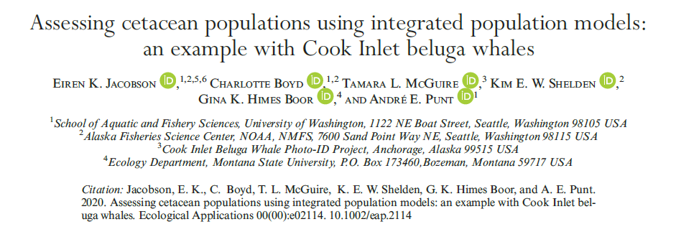

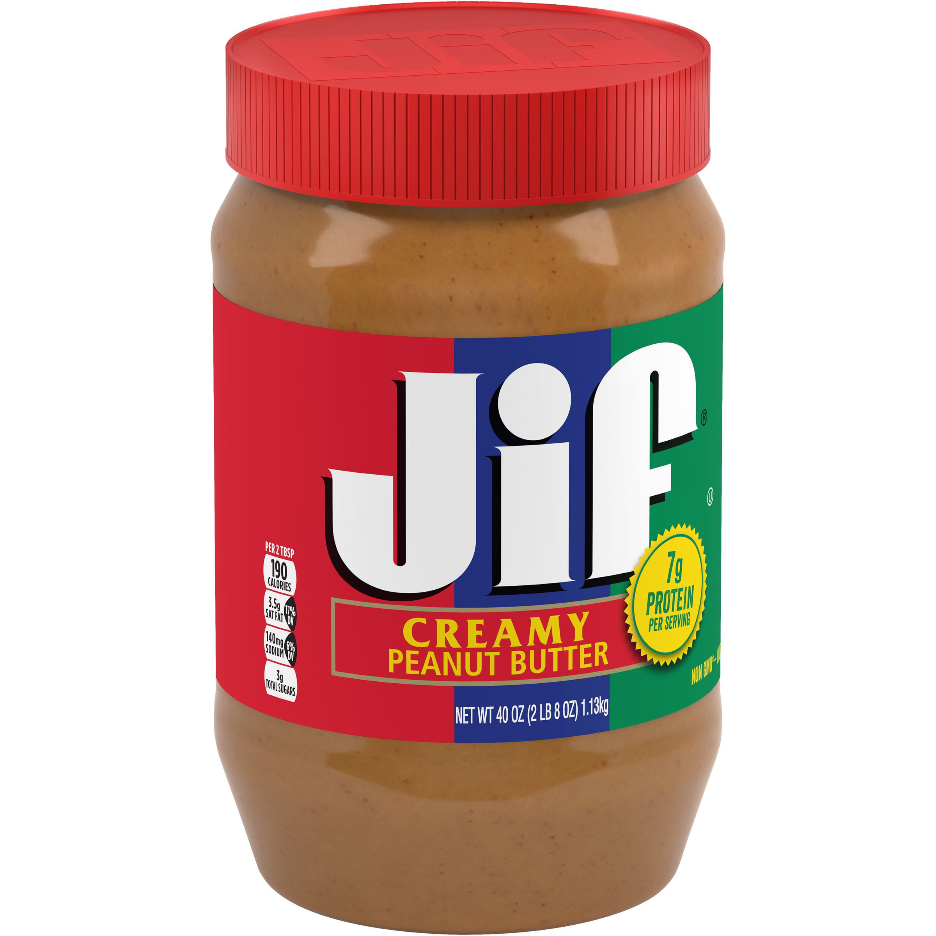
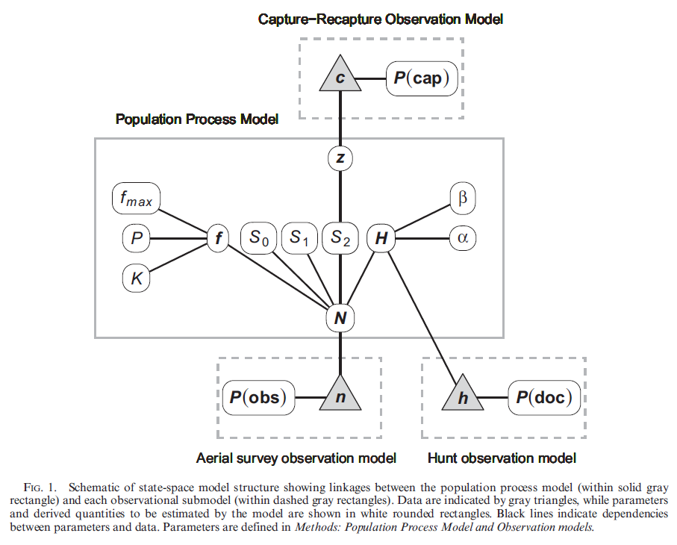
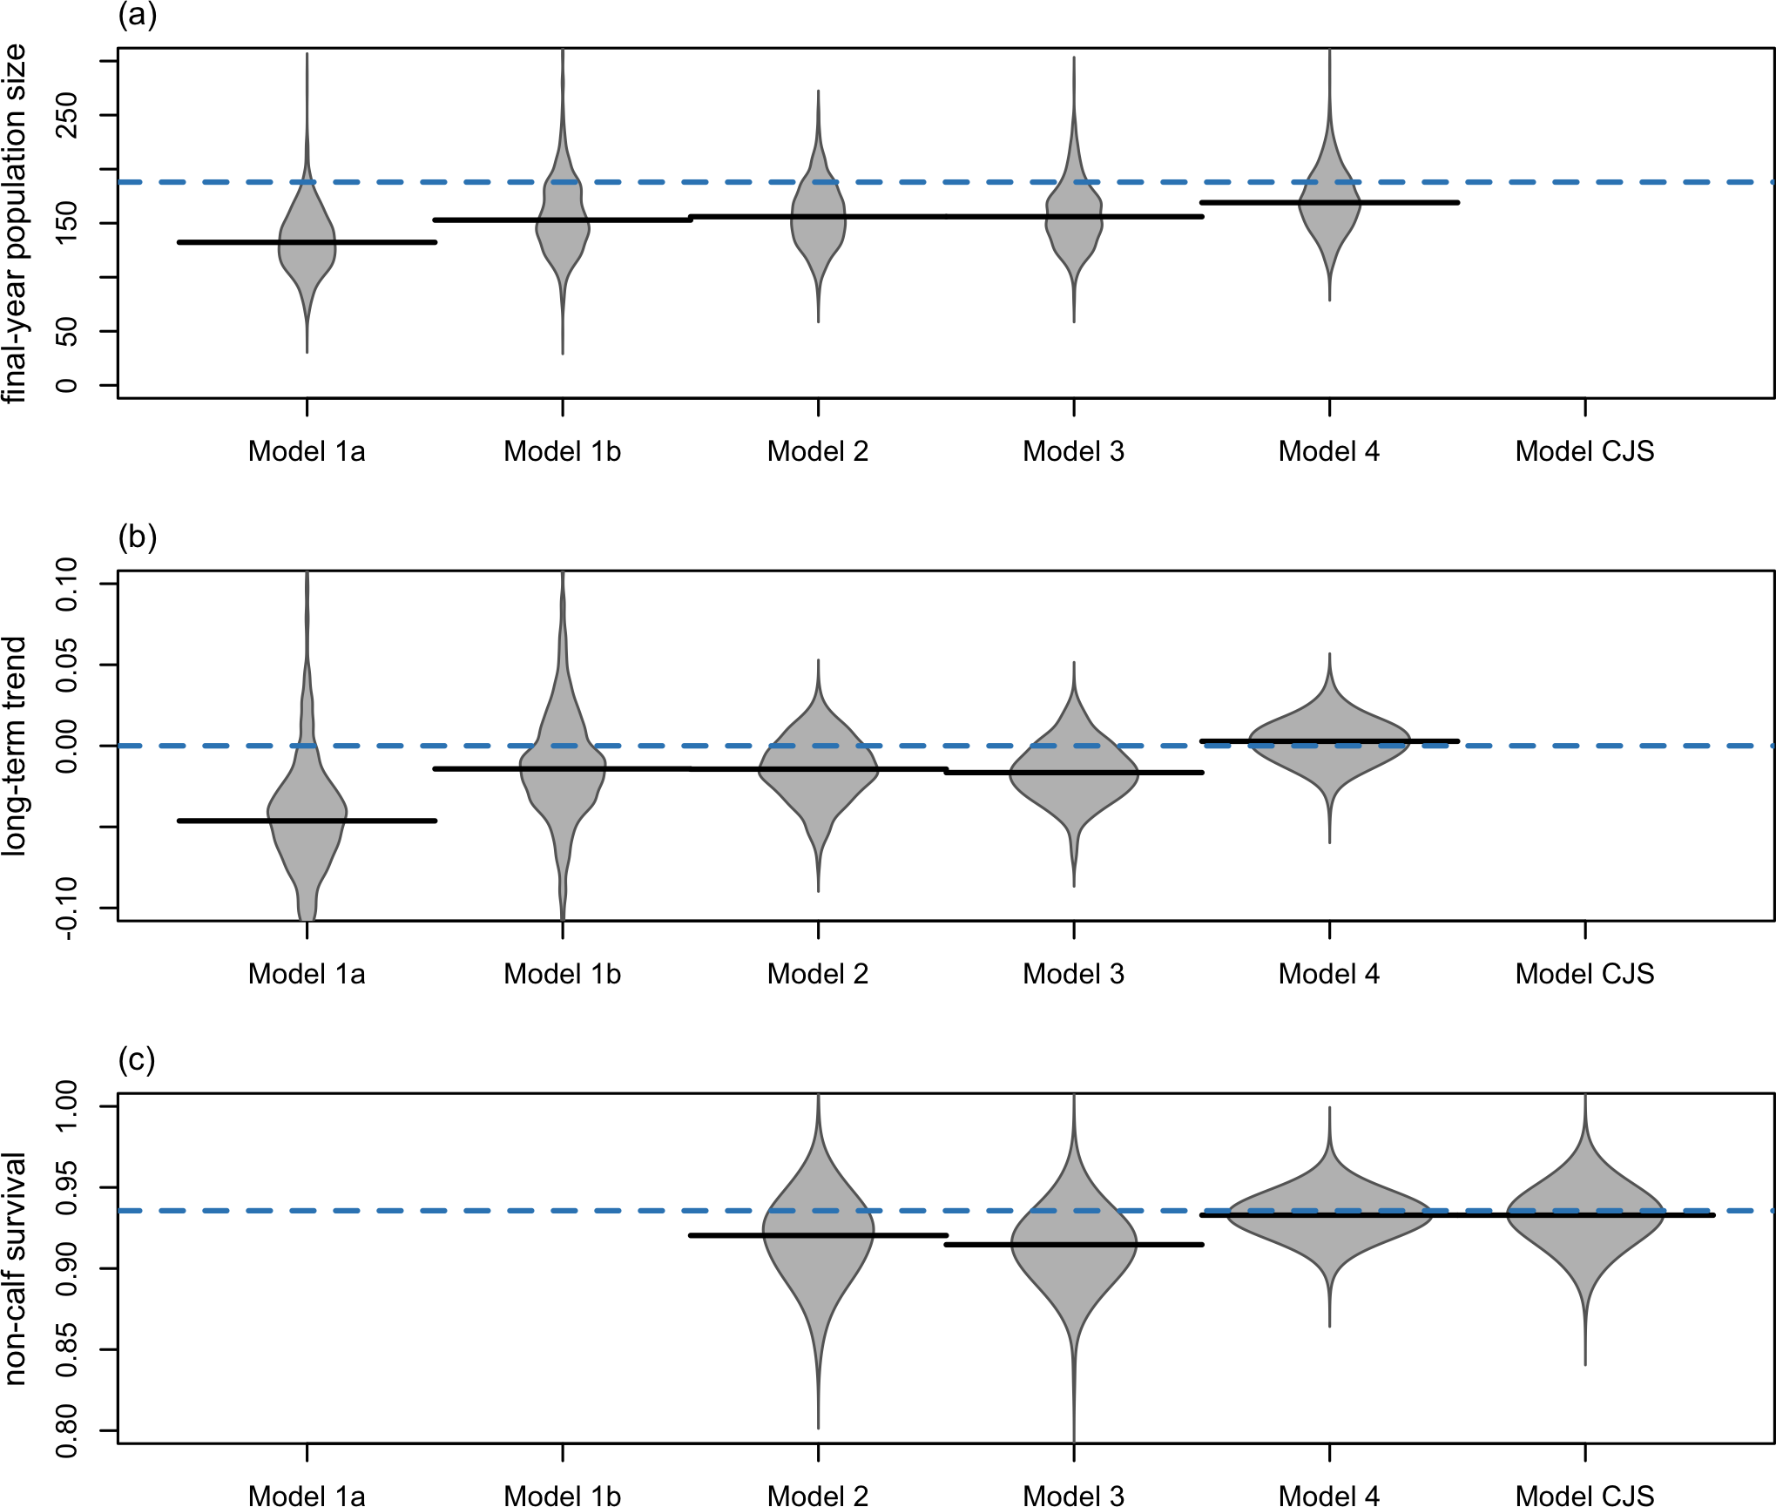
TASK 3: POWER oF MSM EFFORT – IPM SIM TOOL
Prospective power analyses:
Aiming to maximise what can be achieved with MSM (and other!) datastreams
Goal to improve precision of parameter estimates without increasing spending!
Combining multiple data sources – integrated approaches
Earlier warning signs
Integrate across different scales to improve inference about the population-level consequences of local disturbance
Photo-ID / capture-recapture
Passive Acoustic Monitoring
Boyd & Punt 2021: Best integrated model used:
distance-sampling data,
mark-recapture data,
adult:calf index
habitat data.
INTEGRATED APPROACHES
(taste that sweet, sweet, inference….)

Slide 20
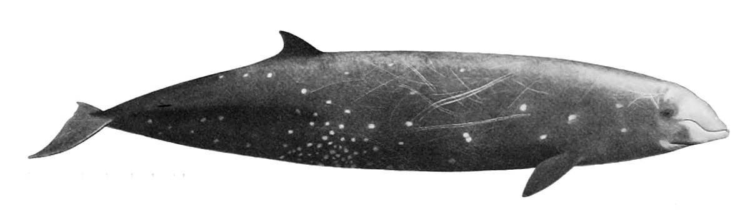
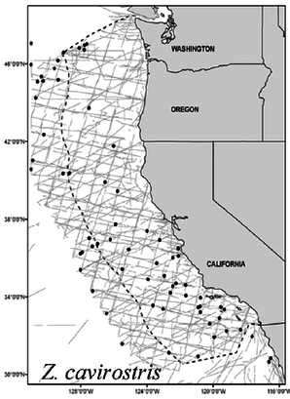
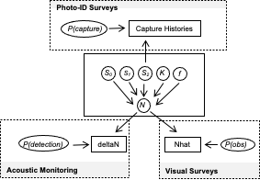
TASK 3: POWER oF MSM EFFORT – IPM SIM TOOL
Goal is to investigate statistical power to detect trends in metapopulations of marine mammals where disturbance and sampling may not be uniformly distributed.
We have developed a simulation tool to evaluate statistical power under different scenarios
Population Simulation
Survey Simulation
Model Simulation

Slide 21
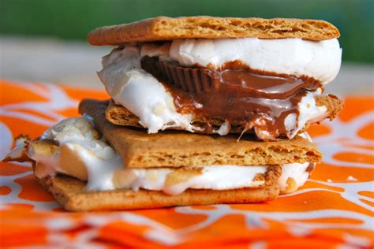

TASK 3: POWER oF MSM EFFORT – IPM SIM TOOL
Model Simulation
State-space Bayesian integrated population model
Central population process model is linked to three observational submodels
(with potential to add more – red box)
Demographic information
Environmental - links
A:C ratio
Prey
Stage-specific survival
Density dependence
Prop. immature
Proxies
?

Slide 22
TASK 3: POWER oF MSM EFFORT – IPM SIM TOOL
Process will be repeated for different scenarios of carrying capacity, disturbance, survey types and survey intensities
Each scenario will be repeated many times to estimate expected power to detect trends
Population Simulation
Survey Simulation
Model Simulation

Slide 23
TASK 3: POWER oF MSM EFFORT – IPM SIM TOOL
Process will be repeated for different scenarios of carrying capacity, disturbance, survey types and survey intensities
Each scenario will be repeated many times to estimate expected power to detect trends
Simulate a hypothetical population similar to Ziphius in SOCAL as a case study
A framework that can be adapted for any species/region/scenario.
Users could specify species, study area size and current density (or density surface).
Initial model ready in Q3 2023
The tool allows simulation of data collection using different types of surveys (line-transect, mark-recapture, passive acoustic monitoring) with different intensities.
And other submodels could be added in future studies.
Environment
Demographic parameters etc.

Slide 24
INITIAL RECOMMENDATIONS FOR MSM SUMMIT?
Are we collecting useful/appropriate data (wrt PCOD for example)?
Yes – likely depends on integration
Occurrence/Exposure
Long term static PAM
Capture-recapture – photo-ID
Visual surveys
Response
Telemetry data – could help inform probability of exposure – aggregate exposure
Consider integrated approaches
i.e. what to do with these data to maximise ROI?
Value of holistic assessment
We’ll know more by the end of the year – as energetic and integrated approaches are further developed.

Slide 25
Thank YOU! QUESTIONS?
Cormac Booth
SMRU Consulting, St Andrews
+358-40-321-9235
cgb@smruconsulting.com
MSM 2023
April 25th 2023

Slide 26
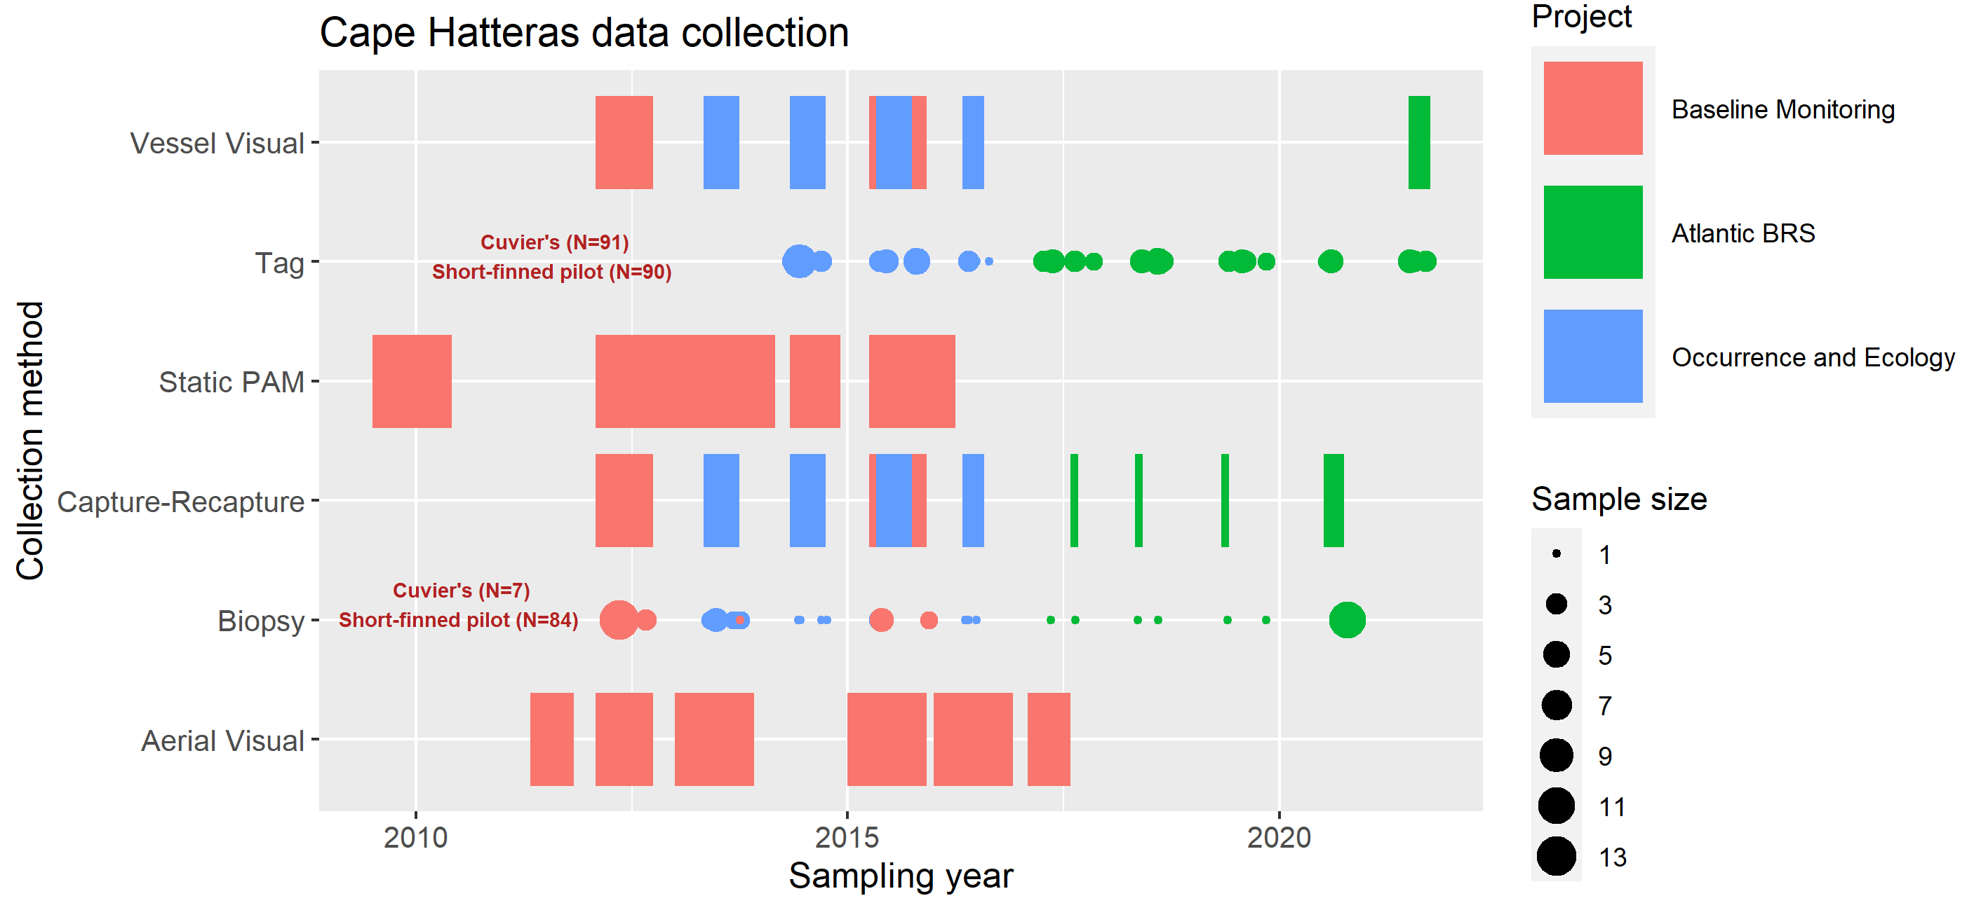
Task 1: POTENTIAL Case studIES
Notes:
While each individual project represents its own time series, combining these datasets provides an opportunity to extend the temporal window of the database and merge multiple different data sources, we can see that there has been a high tagging effort for Cuvier’s beaked whale and Short finned pilot whale, and equally successful biopsy of short finned pilot whale that could be integrated into future for understanding population level disturbance. This schematic only represents three of the studies that occur in the Cape Hatteras region, however there are other data that could be analysed in conjunction with these efforts, such as the Mid-Atlantic Offshore Cetacean study.

Slide 27
Task 3: explorative power analysis (PAM)
Power to detect declines increases above 80% after 40 years of monitoring (1% annual declines)
Increasing the number of density estimates per year could potentially increase power while minimizing additional survey costs
But periods need to be independent
Requires assessment of detection rates
This may be key to earlier detection of a population level change, especially where the population is changing at a lower rate
Figure 1: The power to detect a decline using PAM, p<0.05. In this simulation, 5 localising hydrophones were simulated within the array

